Slide 1
CIS 4517/5517: Data Intensive and Cloud Computing Map-Reduce
Dr. Xubin He
Computer and Information Sciences
Temple University

Slide 2
Credit:
Most slides are adapted from: http://www.mmds.org
Mining of Massive Datasets, by Jure Leskovec, Anand Rajaraman, Jeff Ullman
Read Chapter 2 of “Mining of Massive Datasets” at http://www.mmds.org

Slide 3
Why Hadoop and MapReduce?
In the era of big data, how to process data efficiently in a timely and cost-effective manner?
A platform→Hadoop
A programming model→MapReduce
Together, a reliable, scalable, and distributed computing platform for parallel processing of very large datasets.

Slide 4
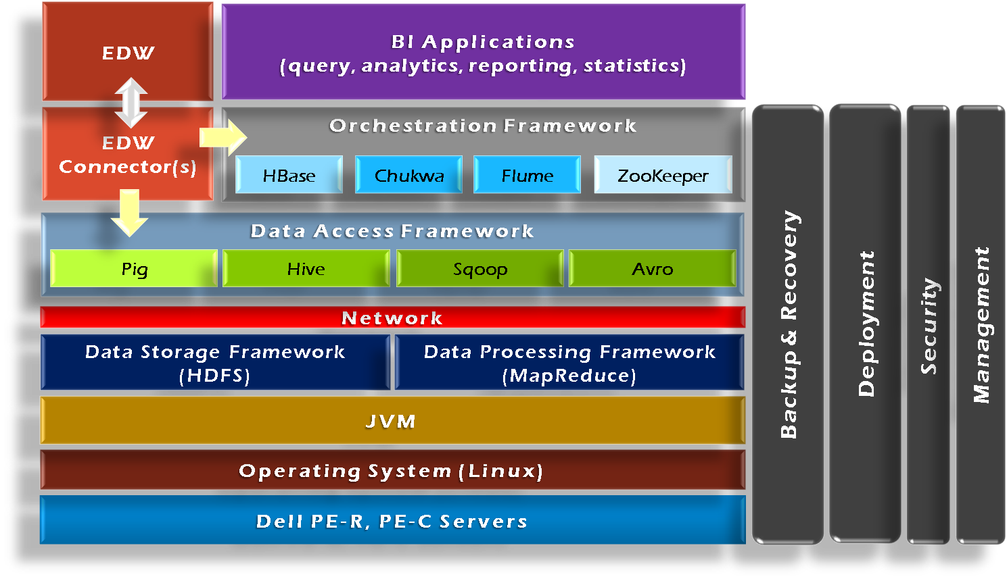

Hadoop Framework Tools
Essential modules: HDFS and MapRedcue

Slide 5
Programming Model: MapReduce
Warm-up task:
We have a huge text document
Count the number of times each distinct word appears in the file
Sample application:
Analyze web server logs to find popular URLs

Slide 6
Task: Word Count
Case 1:
File too large for memory, but all <word, count> pairs fit in memory
Case 2:
Count occurrences of words:
words(doc.txt) | sort | uniq -c
where words takes a file and outputs the words in it, one per a line
Case 2 captures the essence of MapReduce
Great thing is that it is naturally parallelizable

Slide 7
MapReduce: Overview
Sequentially read a lot of data
Map:
Extract something you care about
Group by key: Sort and Shuffle
Reduce:
Aggregate, summarize, filter or transform
Write the result
Outline stays the same, Map and Reduce change to fit the problem

Slide 8
MapReduce: The Map Step
Input
key-value pairs
Intermediate
key-value pairs
k
v
map
k
v
k
v
map
k
v
k
v
…
…
k
v
k
v

Slide 9
MapReduce: The Reduce Step
Output
key-value pairs
Intermediate
key-value pairs
Key-value groups
reduce
k
v
k
v
v
v
k
v
Group
by key
reduce
k
v
k
v
v
k
v
k
v
…
…
…
k
v
k
v
k
v

Slide 10
More Specifically
Input: a set of key-value pairs
Programmer specifies two methods:
Map(k, v) → <k’, v’>*
Takes a key-value pair and outputs a set of key-value pairs
E.g., key is the filename, value is a single line in the file
There is one Map call for every (k,v) pair
Reduce(k’, <v’>*) → <k’, v’’>*
All values v’ with same key k’ are reduced together and processed in v’ order
There is one Reduce function call per unique key k’

Slide 11
MapReduce: Word Counting
Provided by the programmer
Provided by the programmer
MAP:
Read input and produces a set of key-value pairs
Group by key:
Collect all pairs with same key
Reduce:
Collect all values belonging to the key and output
The crew of the space shuttle Endeavor recently returned to Earth as ambassadors, harbingers of a new era of space exploration. Scientists at NASA are saying that the recent assembly of the Dextre bot is the first step in a long-term space-based man/mache partnership. '"The work we're doing now -- the robotics we're doing -- is what we're going to need ……………………..
(The, 1)
(crew, 1)
(of, 1)
(the, 1)
(space, 1)
(shuttle, 1)
(Endeavor, 1)
(recently, 1)
….
(crew, 1)
(crew, 1)
(space, 1)
(the, 1)
(the, 1)
(the, 1)
(shuttle, 1)
(recently, 1)
…
(crew, 2)
(space, 1)
(the, 3)
(shuttle, 1)
(recently, 1)
…
Sequentially read the data
Only sequential reads
Big document
(key, value)
(key, value)
(key, value)

Slide 12
Hadoop Word Count Mapper
public class WordCountMapper extends MapReduceBase
implements Mapper {
private final static Text word = new Text();
private final static IntWritable count = new IntWritable(1);
public void map(WritableComparable key, Writable values,
OutputCollector output, Reporter reporter)
throws IOException {
/* Get line from file */
String line = values.toString();
/* Split into tokens */
StringTokenizer itr = new StringTokenizer(line.toLowerCase(),
" \t.!?:()[],'&-;|0123456789");
while(itr.hasMoreTokens()) {
word.set(itr.nextToken());
/* Emit <token,1> as key + value
output.collect(word, count);
}
}
}

Slide 13
Hadoop Word Count Reducer
public class WordCountReducer extends MapReduceBase
implements Reducer {
public void reduce(WritableComparable key, Iterator values,
OutputCollector output, Reporter reporter)
throws IOException {
int cnt = 0;
while(values.hasNext()) {
IntWritable ival = (IntWritable) values.next();
cnt += ival.get();
}
output.collect(key, new IntWritable(cnt));
}
}

Slide 14
Word Count Using MapReduce
map(key, value):
// key: document name; value: text of the document
for each word w in value:
emit(w, 1)
reduce(key, values):
// key: a word; value: an iterator over counts
result = 0
for each count v in values:
result += v
emit(key, result)

Slide 15
Map-Reduce: Environment
Map-Reduce environment takes care of:
Partitioning the input data
Scheduling the program’s execution across a set of machines
Performing the group by key step
Handling machine failures
Managing required inter-machine communication

Slide 16
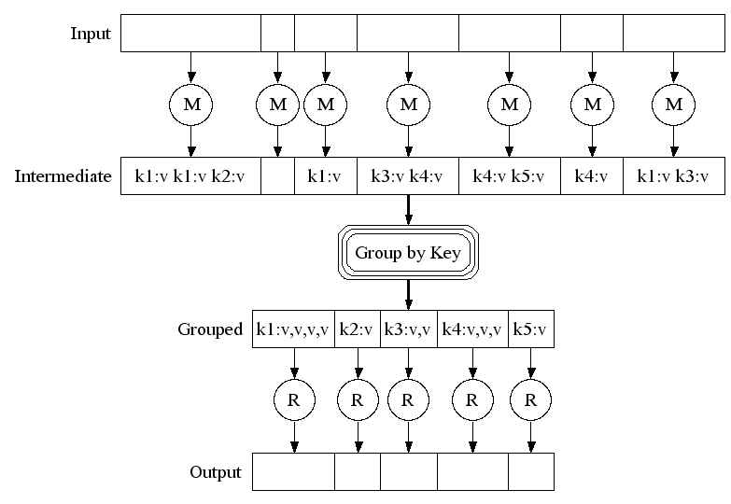
Map-Reduce: A diagram
Big document
MAP:
Read input and produces a set of key-value pairs
Group by key:
Collect all pairs with same key
(Hash merge, Shuffle, Sort, Partition)
Reduce:
Collect all values belonging to the key and output

Slide 17
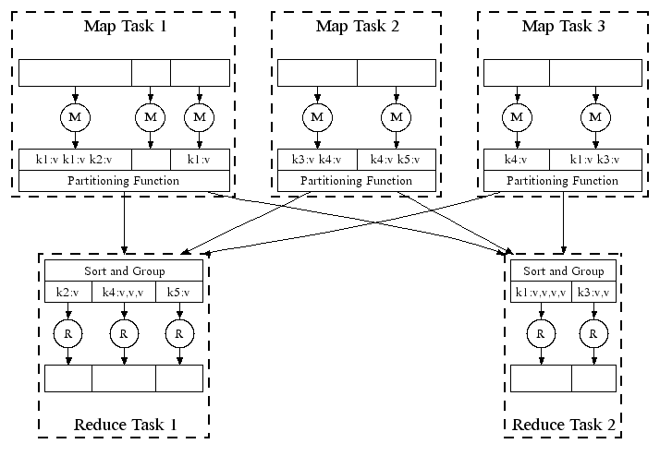
Map-Reduce: In Parallel
All phases are distributed with many tasks doing the work

Slide 18
Map-Reduce
Programmer specifies:
Map and Reduce and input files
Workflow:
Read inputs as a set of key-value-pairs
Map transforms input kv-pairs into a new set of k'v'-pairs
Sorts & Shuffles the k'v'-pairs to output nodes
All k’v’-pairs with a given k’ are sent to the same reduce
Reduce processes all k'v'-pairs grouped by key into new k''v''-pairs
Write the resulting pairs to files
All phases are distributed with many tasks doing the work
Input 0
Input 1
Input 2
Map 0
Map 1
Map 2
Shuffle
Reduce 0
Reduce 1
Out 0
Out 1

Slide 19
Data Flow
Input and final output are stored on a distributed file system (FS):
Scheduler tries to schedule map tasks “close” to physical storage location of input data
Intermediate results are stored on local FS of Map and Reduce workers
Output is often input to another MapReduce task

Slide 20
Coordination: Master
Master node takes care of coordination:
Task status: (idle, in-progress, completed)
Idle tasks get scheduled as workers become available
When a map task completes, it sends the master the location and sizes of its R intermediate files, one for each reducer
Master pushes this info to reducers
Master pings workers periodically to detect failures

Slide 21
Distributed Execution Overview
User
Program
fork
fork
fork
Master
assign
map
assign
reduce
Input Data
Worker
write
Output
File 0
local
write
Worker
Split 0
read
Split 1
Worker
Split 2
Output
File 1
Worker
Worker
remote
read,
sort

Slide 22
Dealing with Failures
Map worker failure
Map tasks completed or in-progress at worker are reset to idle
Reduce workers are notified when task is rescheduled on another worker
Reduce worker failure
Only in-progress tasks are reset to idle
Reduce task is restarted
Master failure
MapReduce task is aborted and client is notified

Slide 23
How many Map and Reduce jobs?
M map tasks, R reduce tasks
Rule of a thumb:
Make M much larger than the number of nodes in the cluster
One DFS chunk per map is common
Improves dynamic load balancing and speeds up recovery from worker failures
Usually R is smaller than M
Because output is spread across R files

Slide 24
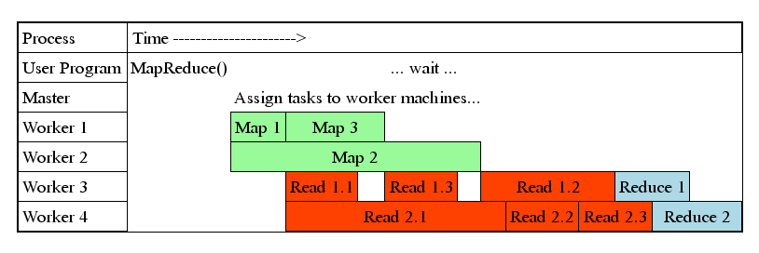
Task Granularity & Pipelining
Fine granularity tasks: map tasks >> machines
Minimizes time for fault recovery
Can do pipeline shuffling with map execution
Better dynamic load balancing

Slide 25
Co-occurrence Matrix
A common task in corpus linguistics and statistical natural language processing
E.g., Language Models - assign probabilities to sequences of words
The co-occurrence matrix of a corpus is a square n×n matrix where n is the number of unique words in the corpus
A cell m_{ij} contains the number of times word w_{i} co-occurs with word w_{j} within a specific context
Context: a sentence, paragraph, or a document
Other applications
Correlation mining, such as customers who buy this tend to also buy that.

Slide 26
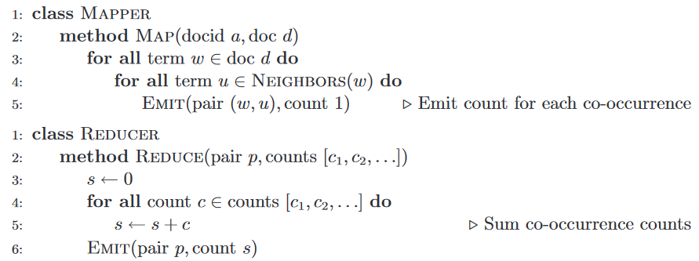
Pseudo-code word co-occurence

Slide 27
Resources
Hadoop Wiki
Introduction
http://wiki.apache.org/lucene-hadoop/
Getting Started
http://wiki.apache.org/lucene-hadoop/GettingStartedWithHadoop
Map/Reduce Overview
http://wiki.apache.org/lucene-hadoop/HadoopMapReduce
http://wiki.apache.org/lucene-hadoop/HadoopMapRedClasses
Eclipse Environment
http://wiki.apache.org/lucene-hadoop/EclipseEnvironment
Javadoc
http://lucene.apache.org/hadoop/docs/api/

Slide 28
Next
Map-reduce examples
Quiz 3:
Distributed file systems (GFS, HDFS) and map-reduce

